Slide 1
Multi-Assets Prediction
Chenhao Zhu - 1009190135
Zimu Xu - 1003537283

Slide 2
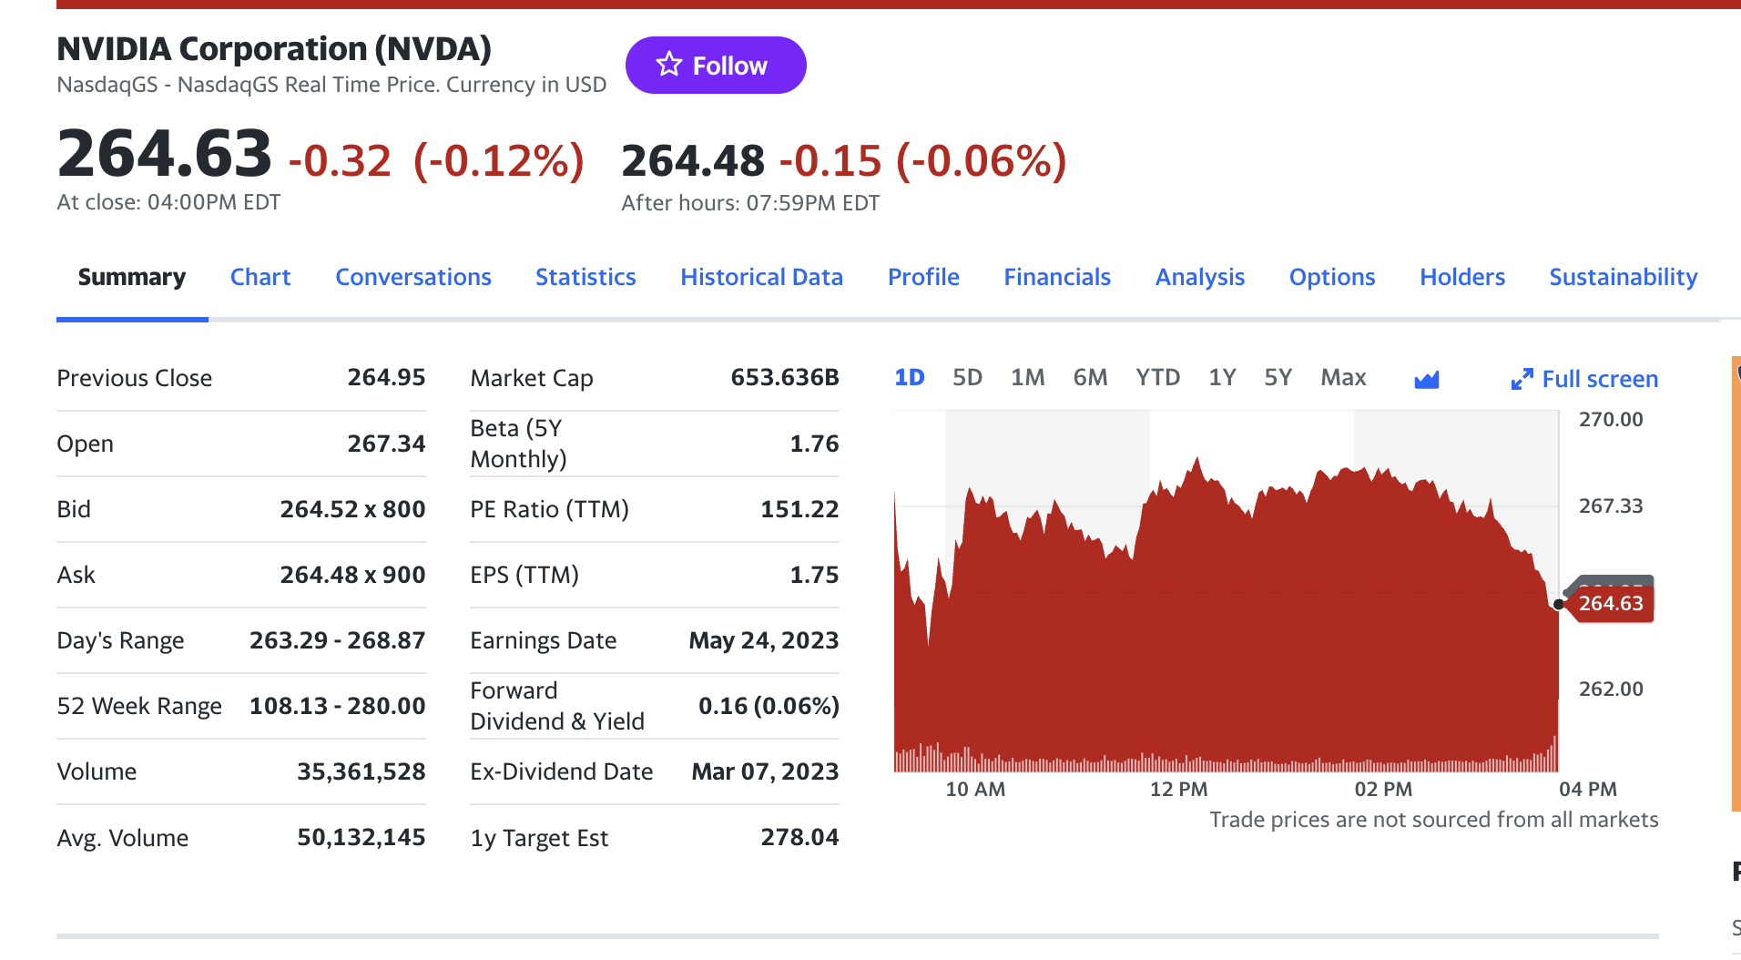
Company Overview
NVIDIA Corporation

Slide 3
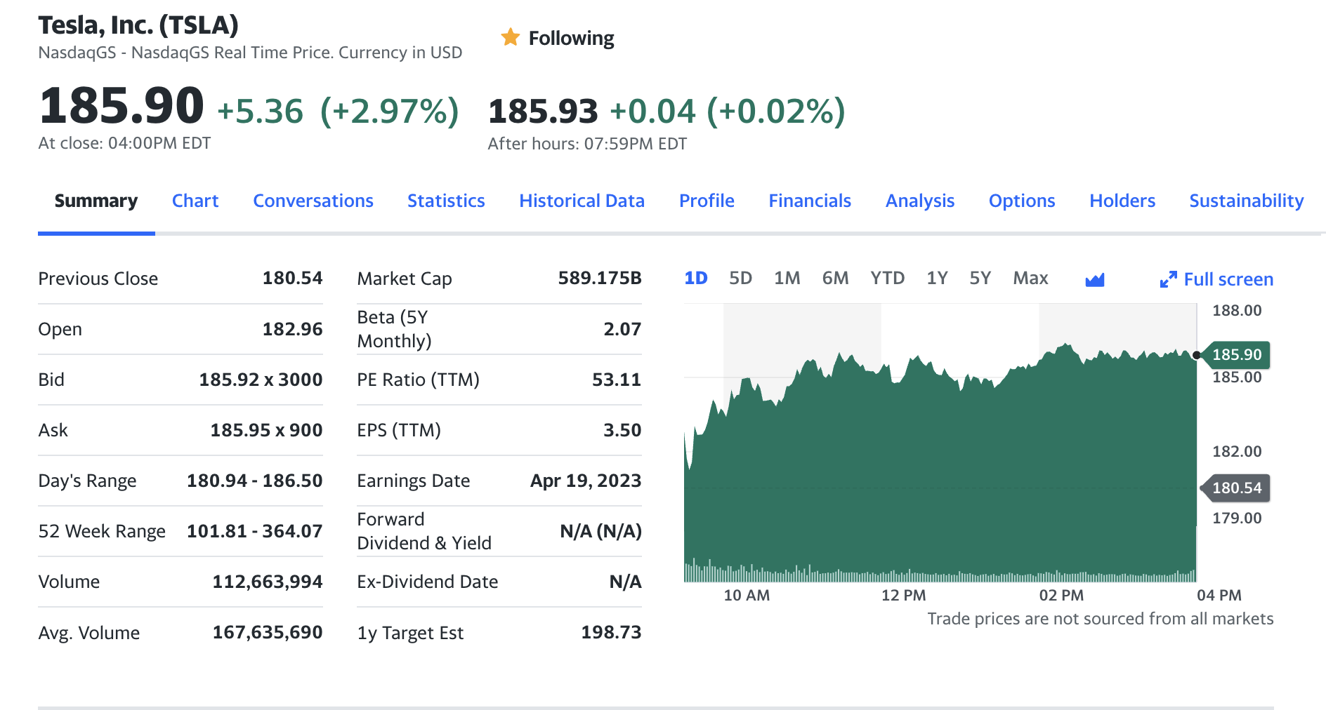
Company Overview
Tesla

Slide 4
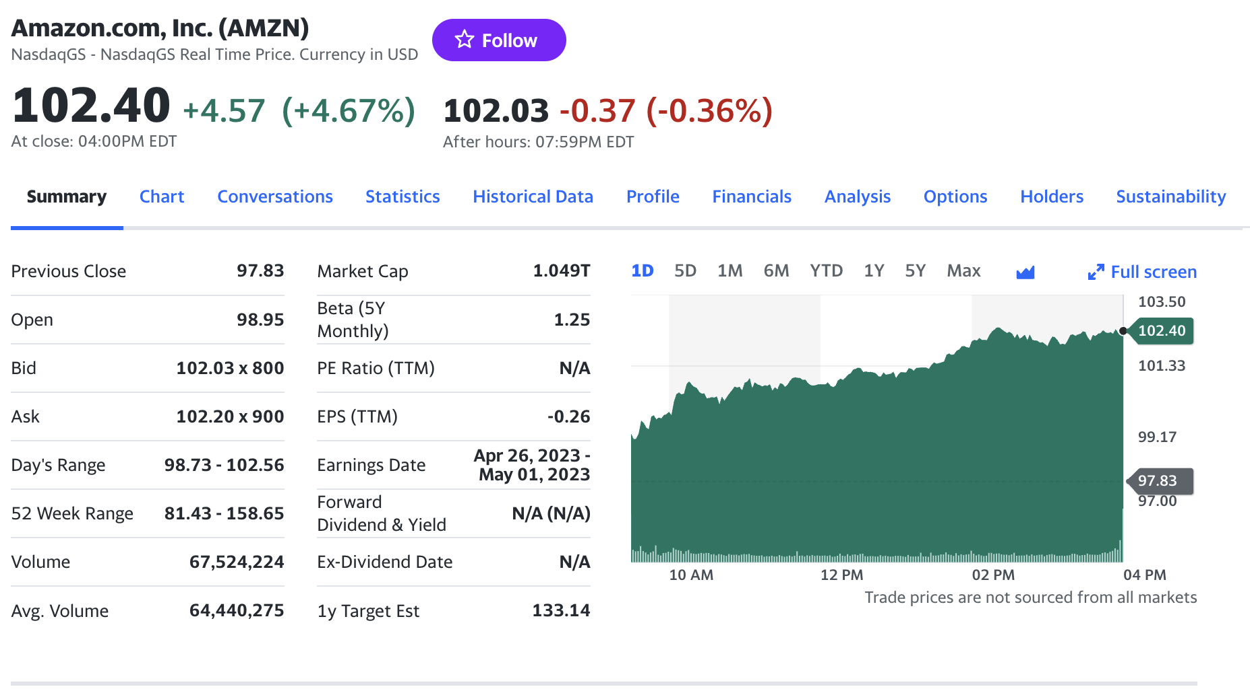
Company Overview
Amazon

Slide 5
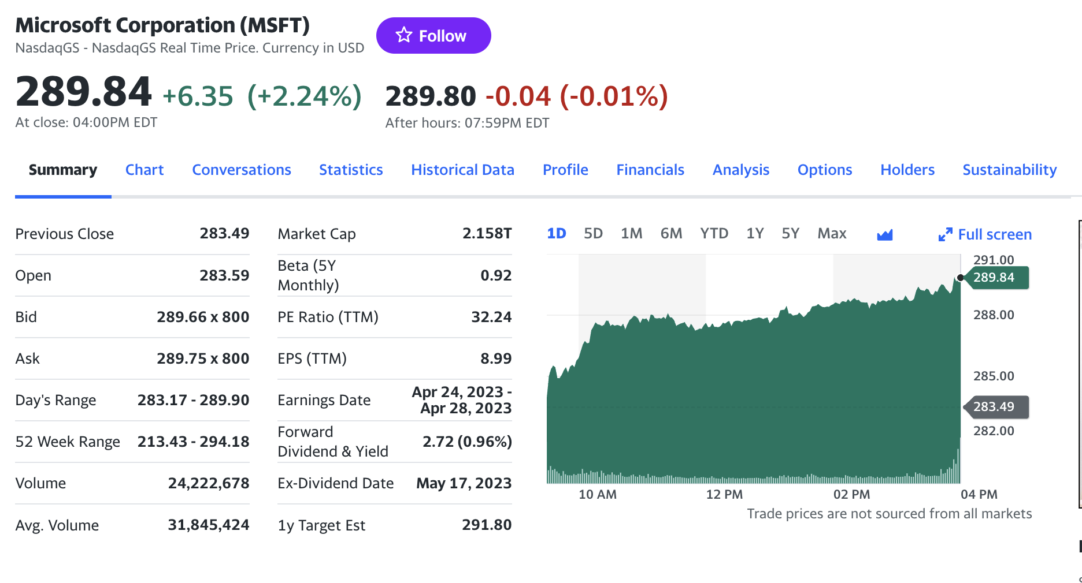
Company Overview
Microsoft

Slide 6

Project Goal
Predict Next day’s Stock price of 4 companies
Check Expected return using long-short trading method
Compare model performance

Slide 7
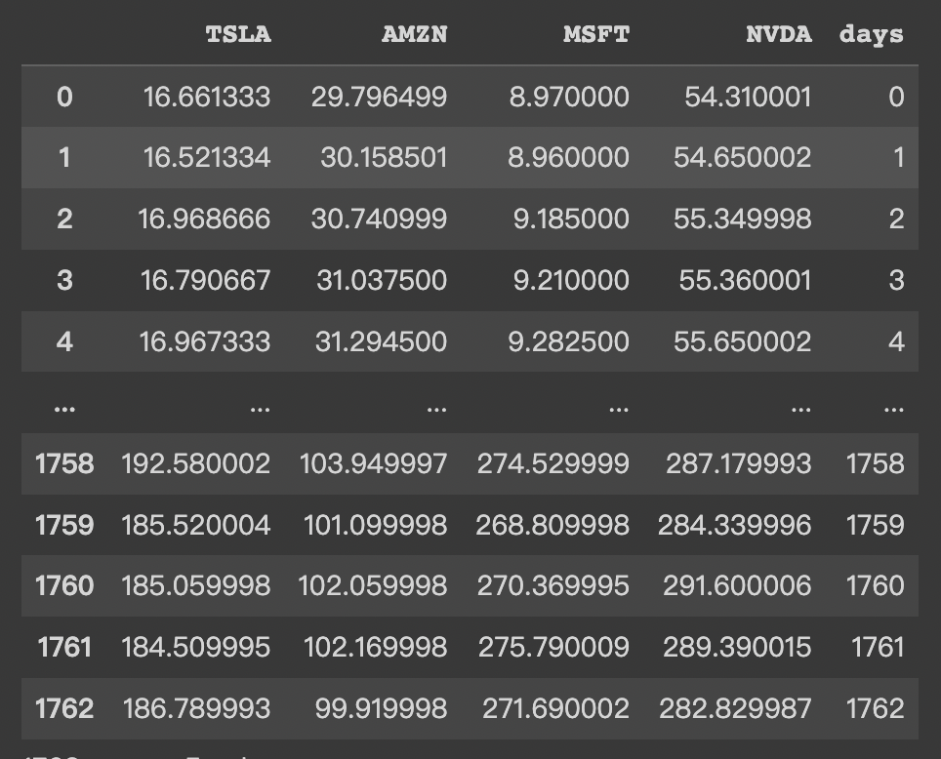
Data Importing and Preprocessing
Combine all 4 stocks data into one table

Slide 8
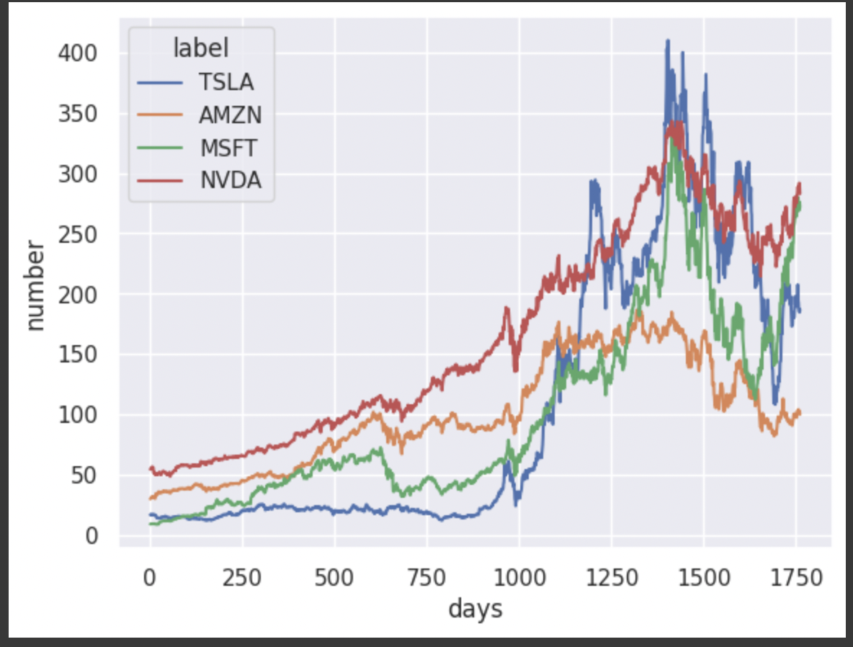
Visualization - 4 Stocks show similar trend, but different prices

Slide 9
Modeling Idea
Using many financial indicators and factor models as input, apply machine learning model such as regulized regression model to predict next day’s stock price.
Could we just use stock price to do the prediction ? Collecting financial factors requires stable and real-time update on daily data. We could simply make prediction with previous stock price only.
How many number of previous day should we choose to make prediction on next day’s price ? This is a hyperparameters that we need to tune. We picked previous 30 days’ stock prices as input in this project.

Slide 10
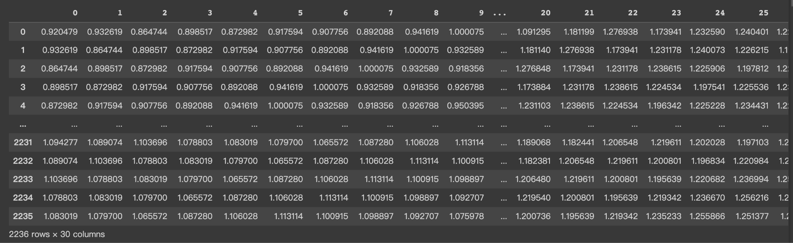
Data Preparation - Merge 4 companies’ stock price vertically

Slide 11
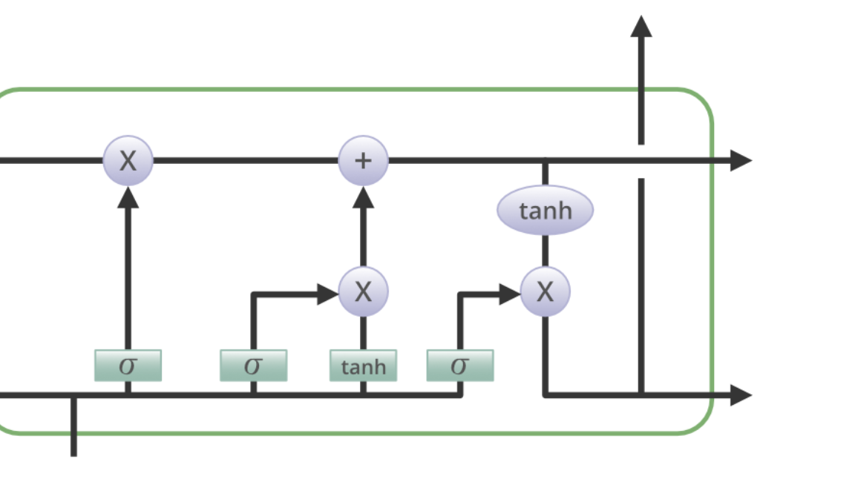
Model Overview - Deep learning - LSTM

Slide 12
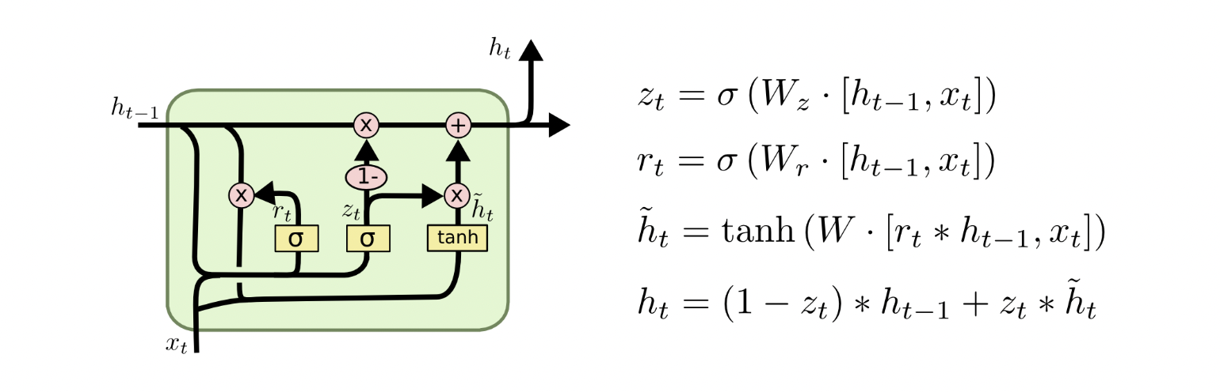
Structure of LSTM

Slide 13
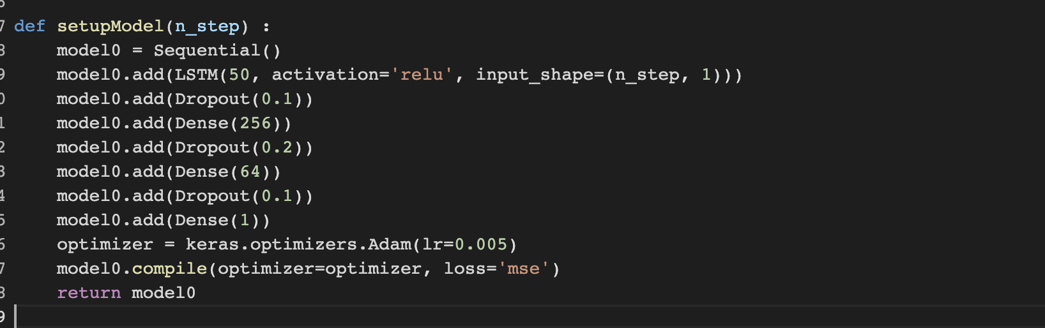
LSTM Modeling

Slide 14
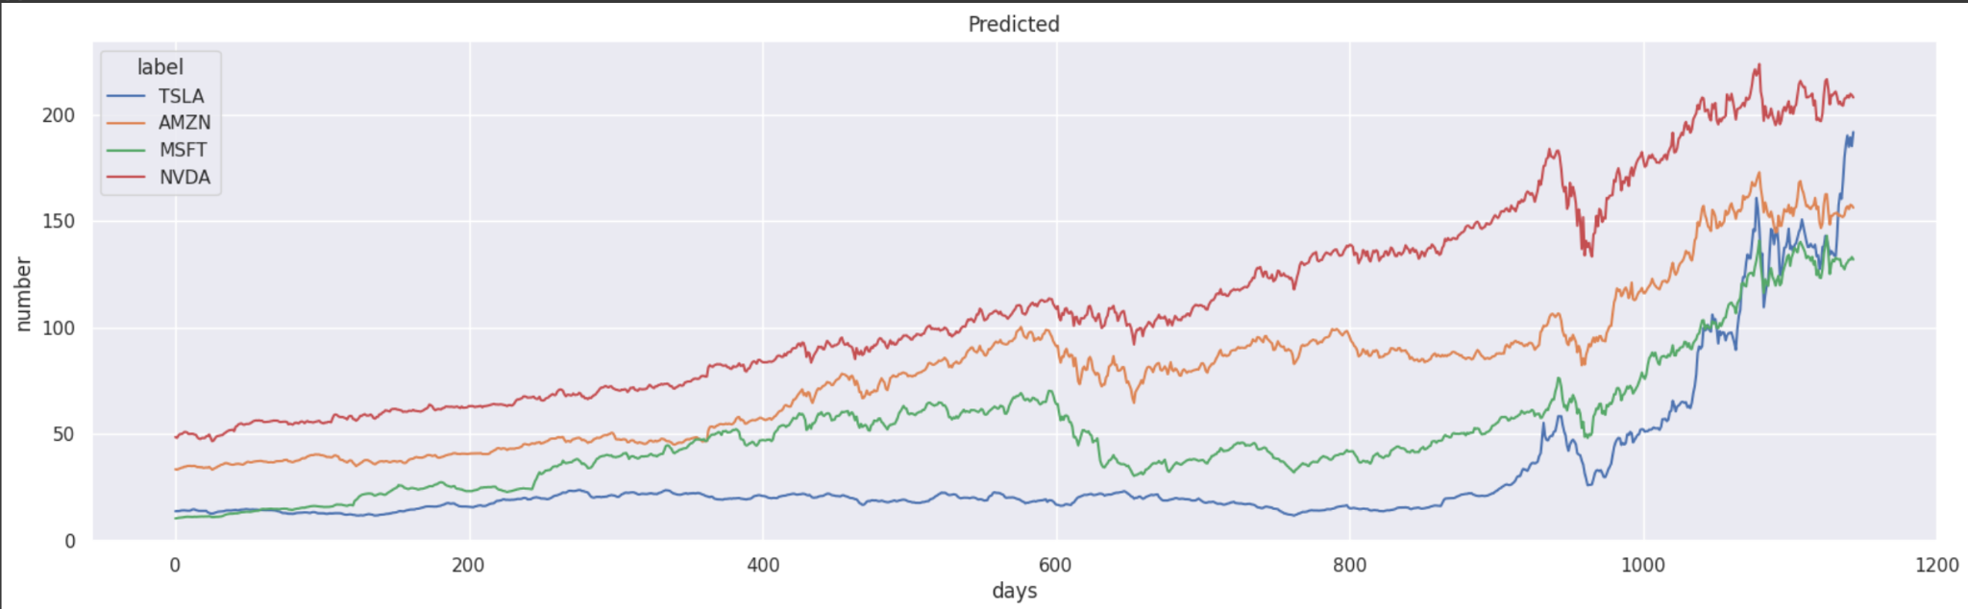
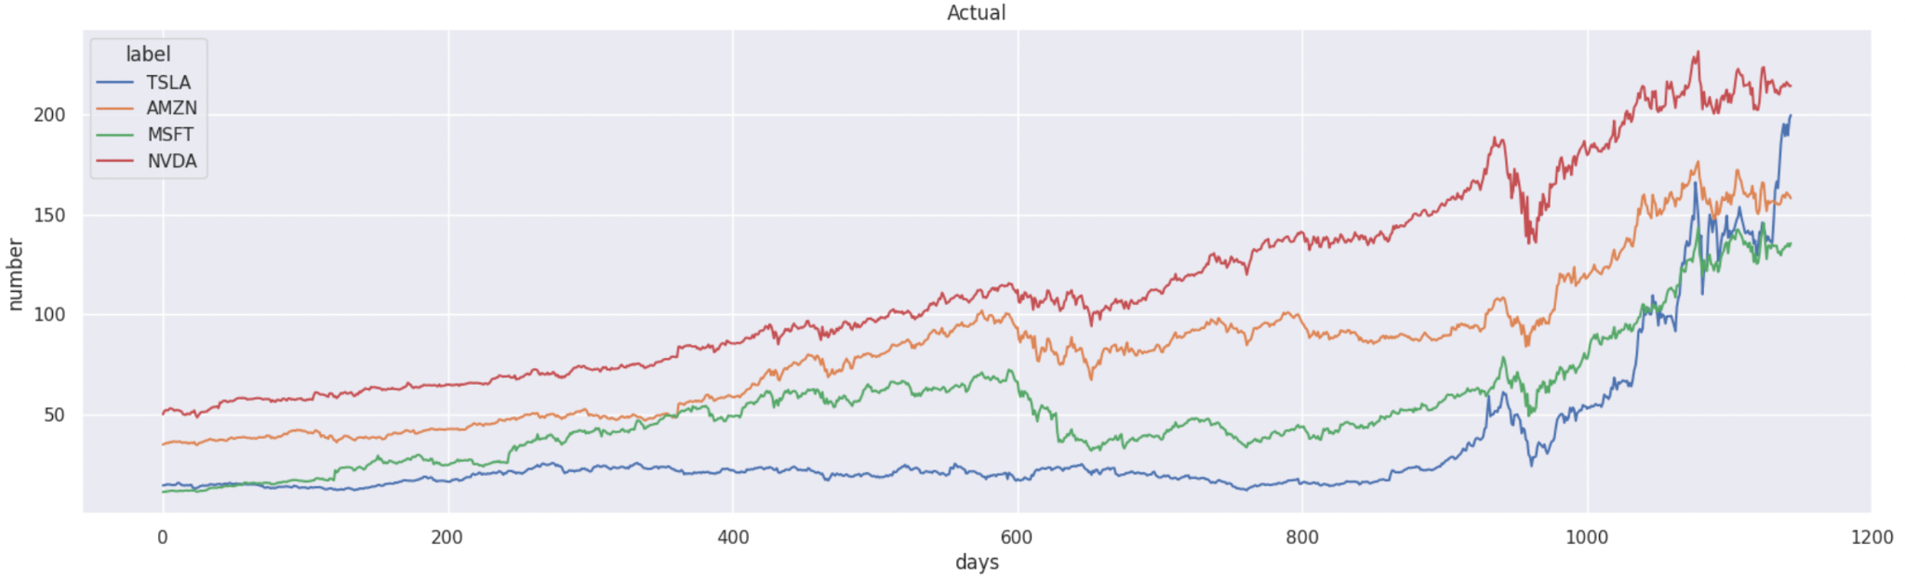
Train : Predicted VS Actual Stock Price

Slide 15
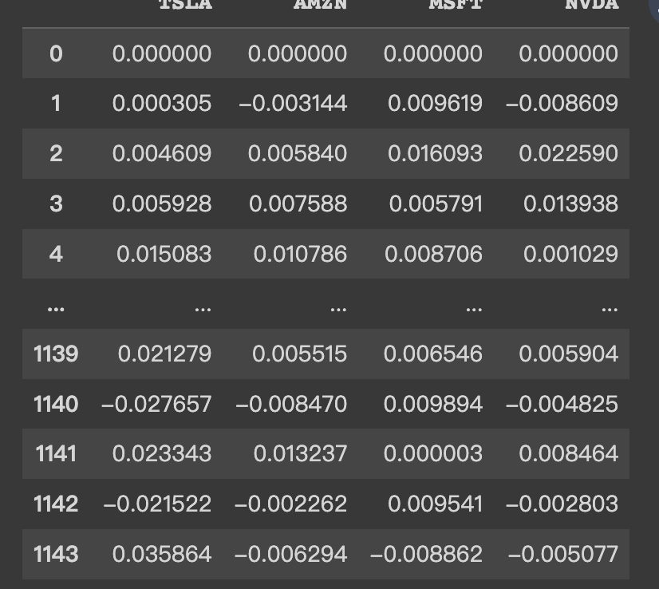
Expected Return
Calculated using help function :
functions.py

Slide 16
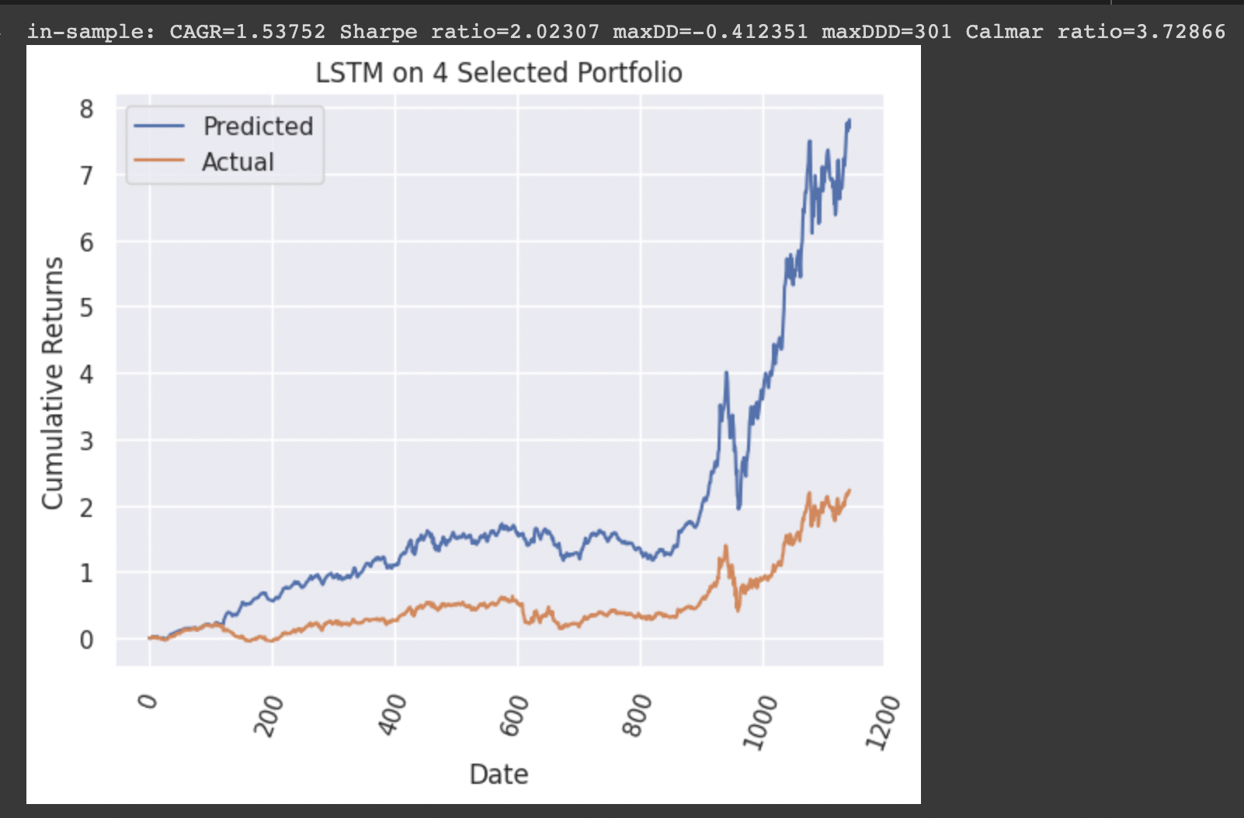
Predicted Cumulative Return VS Actual Return

Slide 17
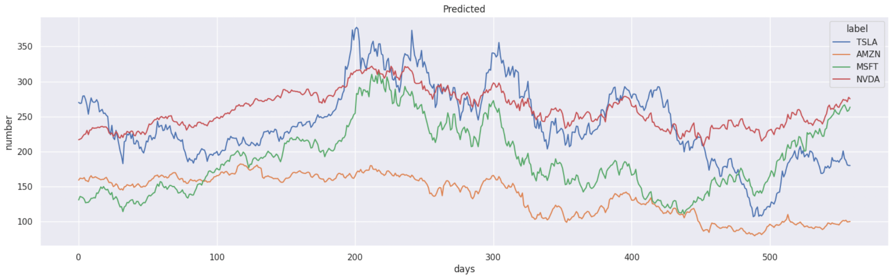
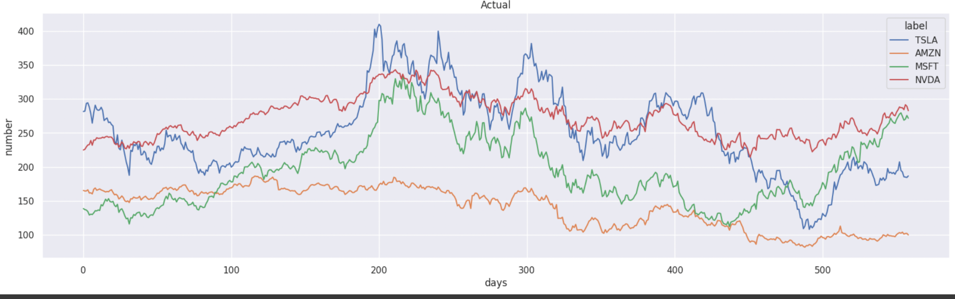
Test : Predicted VS Actual Stock Price

Slide 18
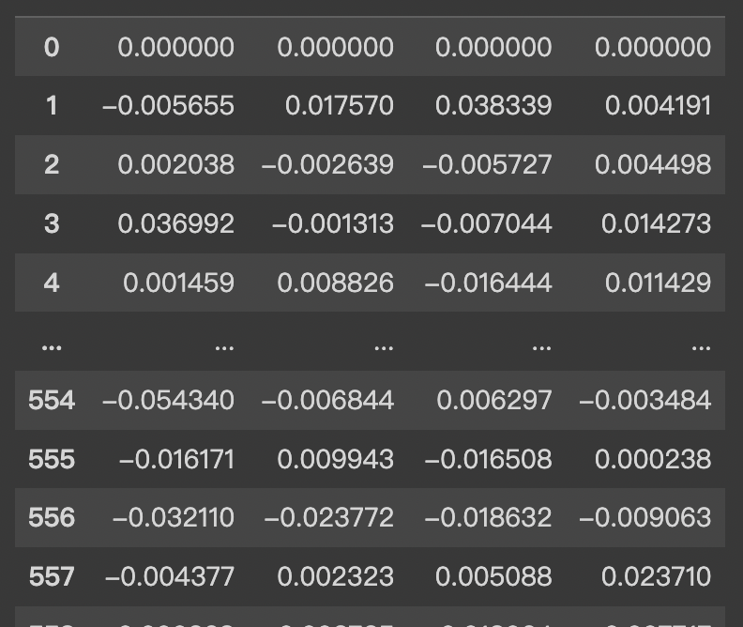
Expected Return
Calculated using help function :
functions.py

Slide 19
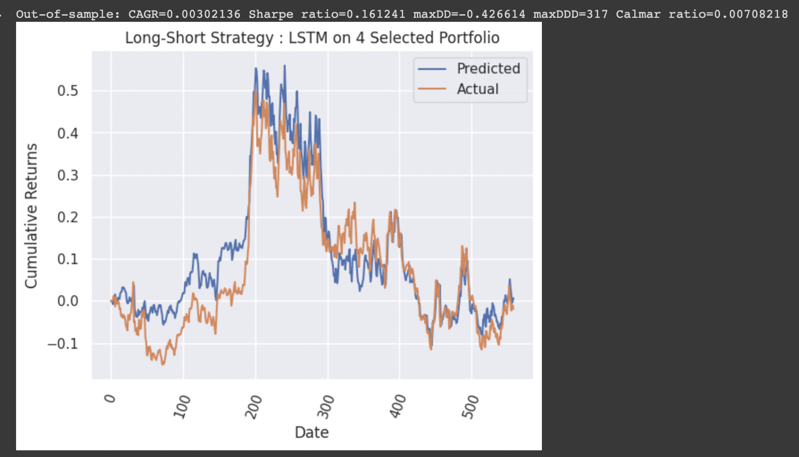
Predicted Cumulative Return VS Actual Return

Slide 20
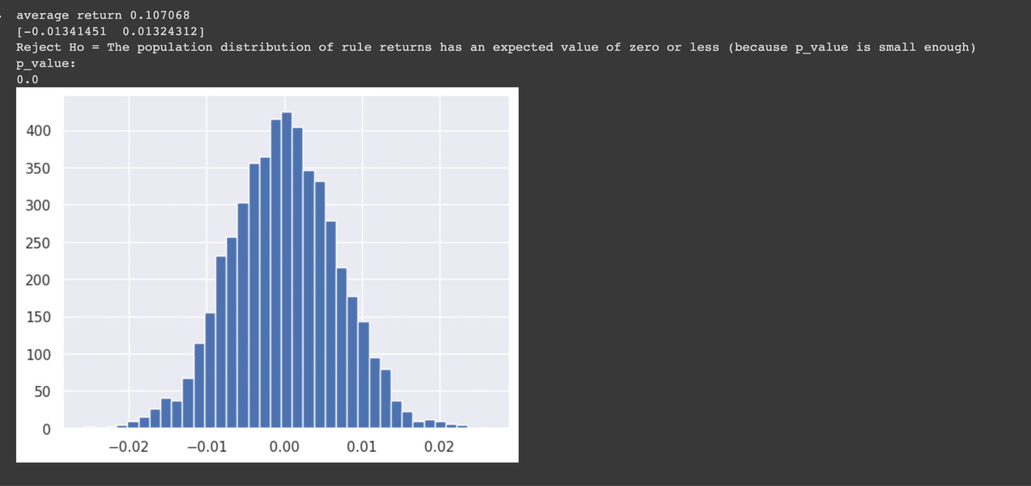
White Reality Check - LSTM prediction

Slide 21
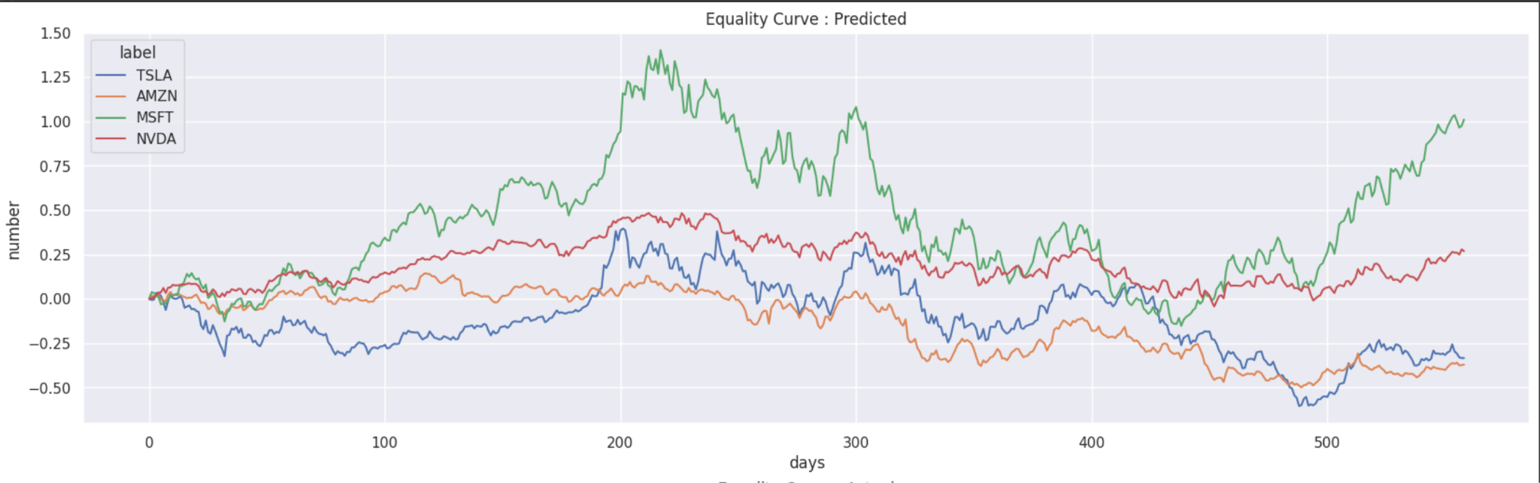
Equity Curve - LSTM

Slide 22
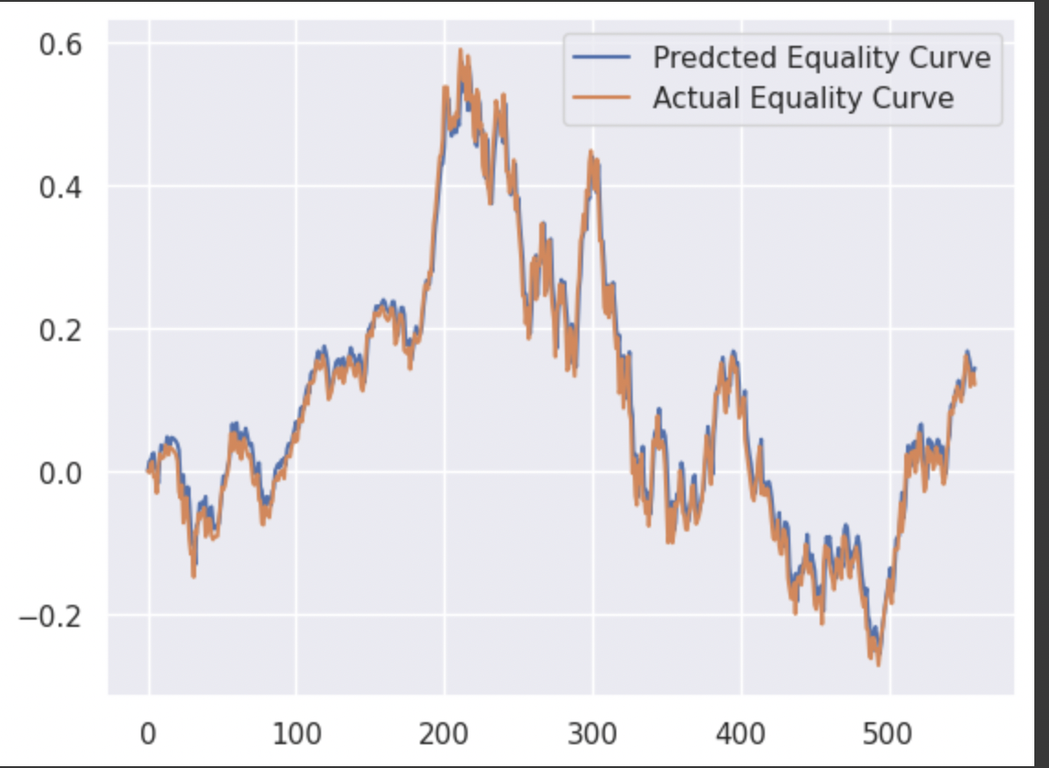
Average Equity Curve - LSTM - Actual VS Predicted

Slide 23
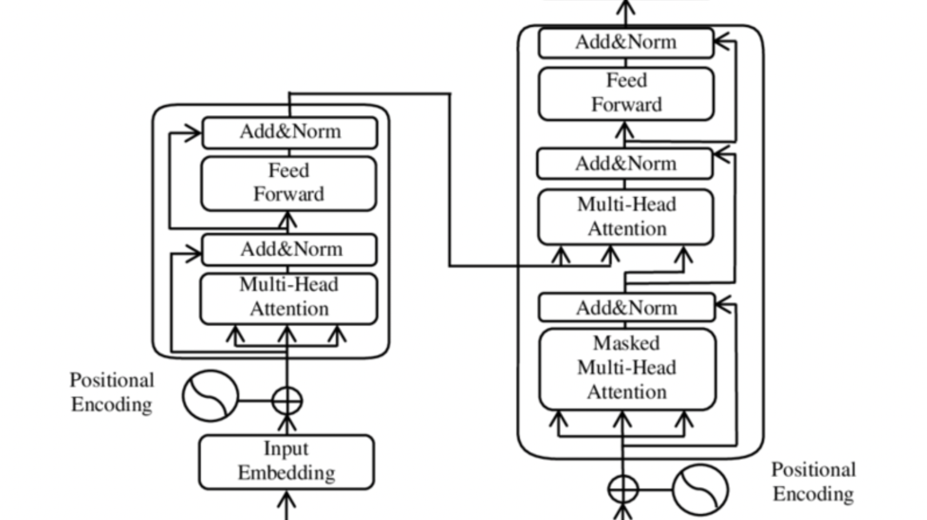
Model Overview - Deep learning - Transformer

Slide 24
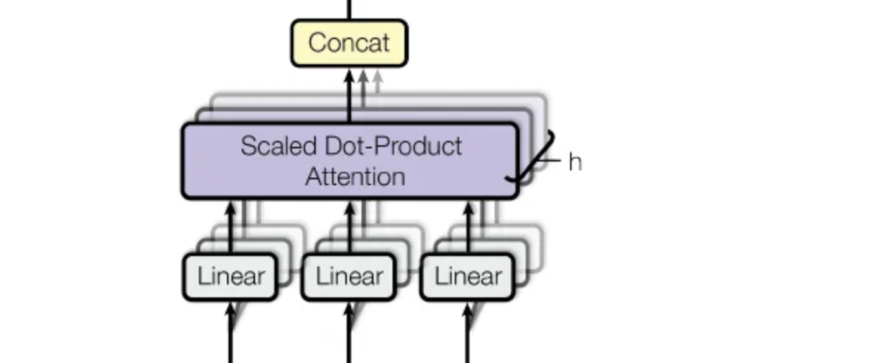
“Attention is ALL you need”
self-attention allows a transformer model to attend to different parts of the same input sequence

Slide 25
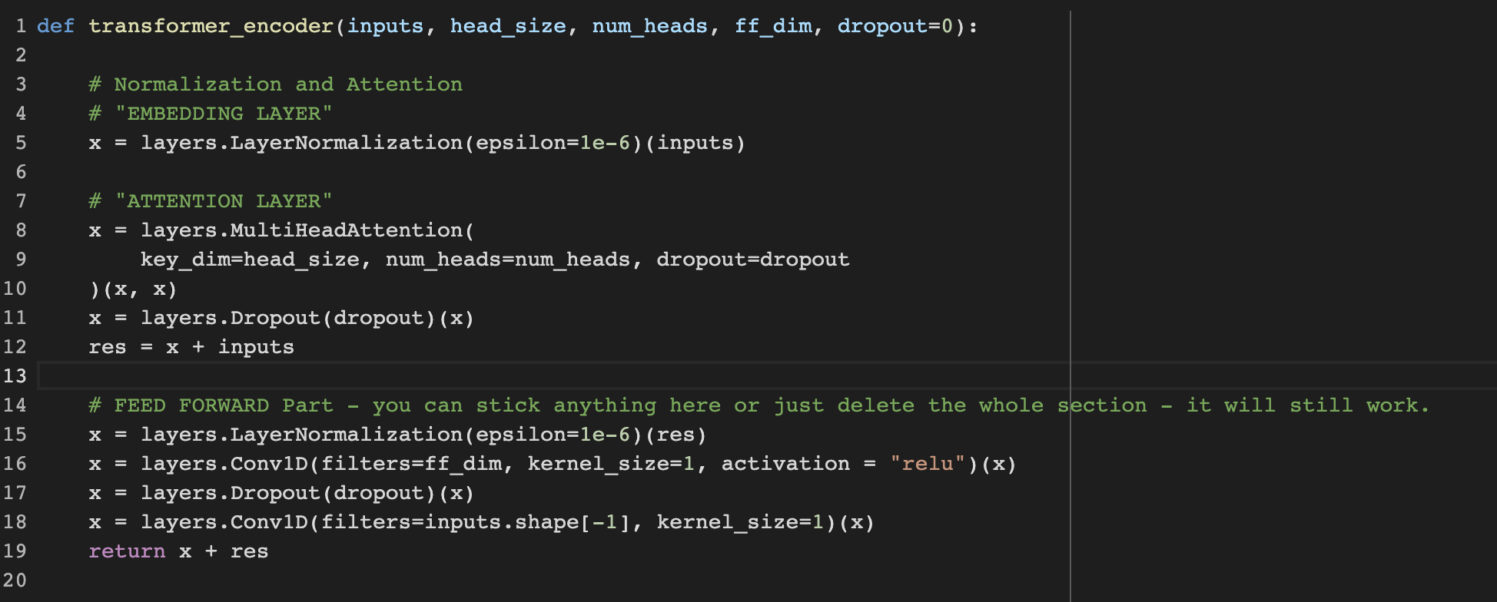
Self-Attention Modeling

Slide 26
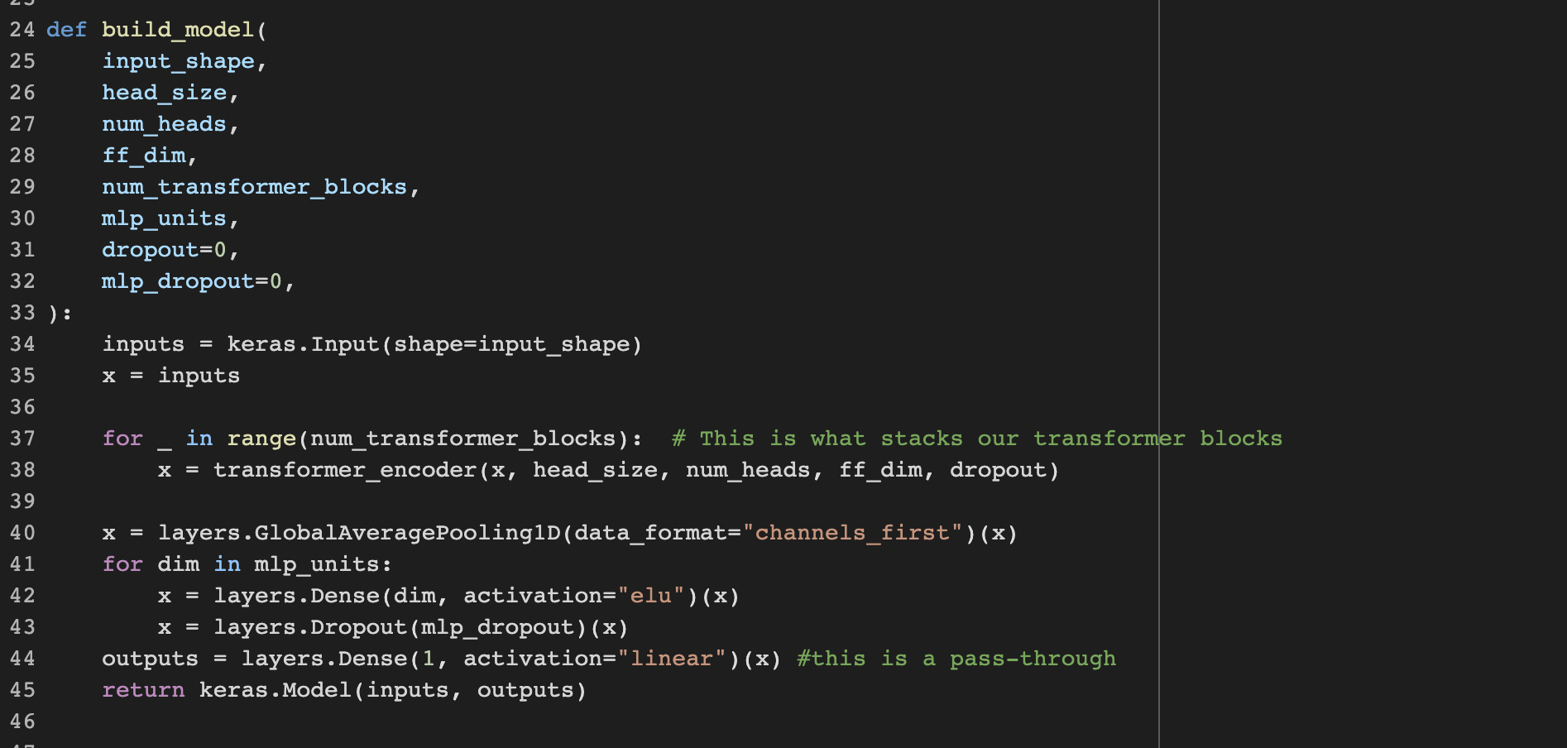
Full Modeling - Transformer

Slide 27
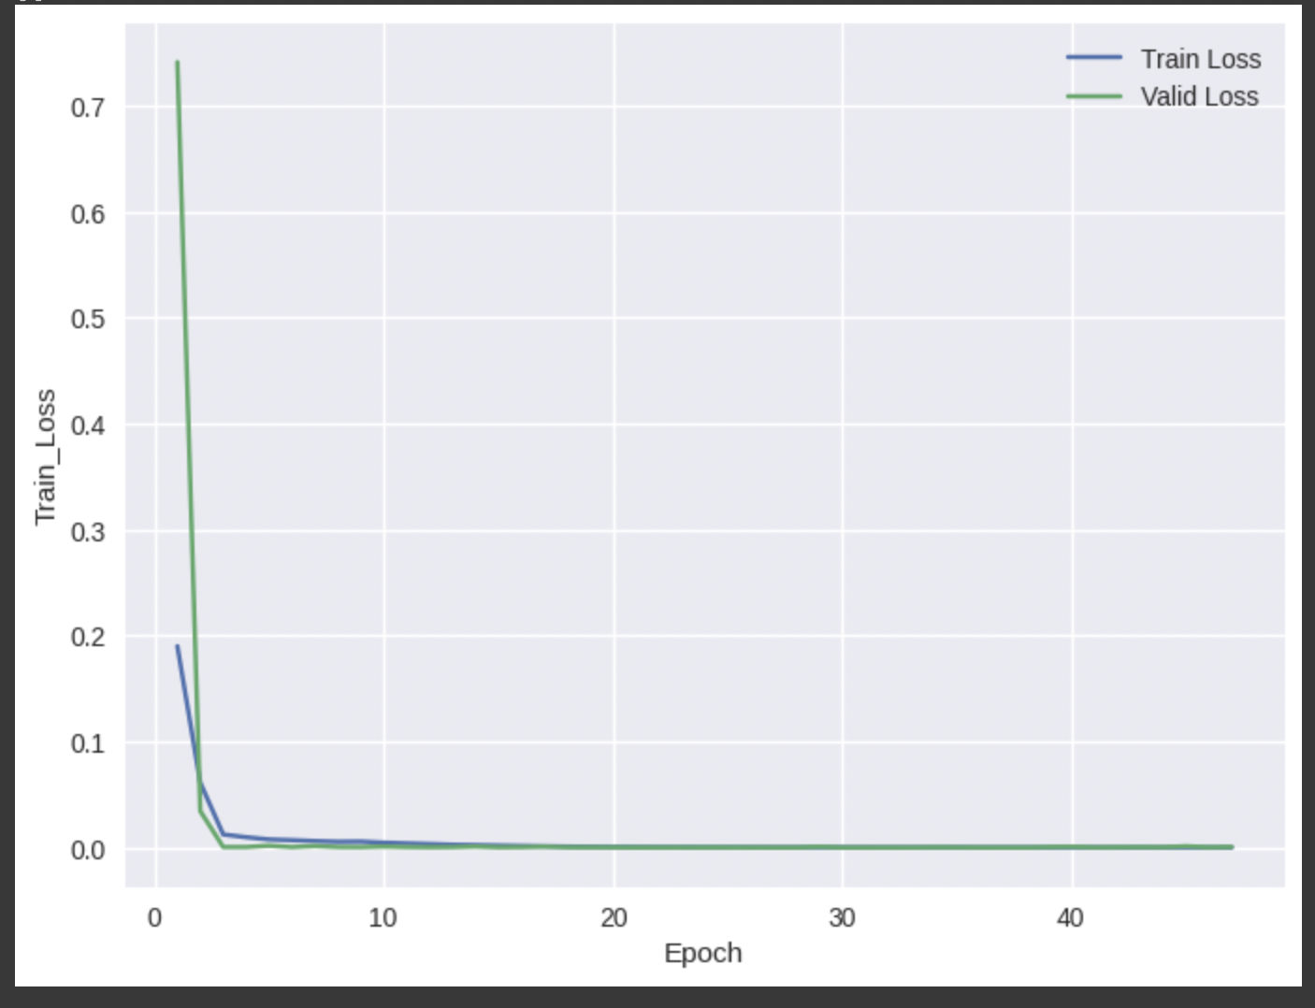
Training with hyper-parameters
Number of Epoches : 50,
Batch size : 32,
Learning Rate : 0.0001

Slide 28
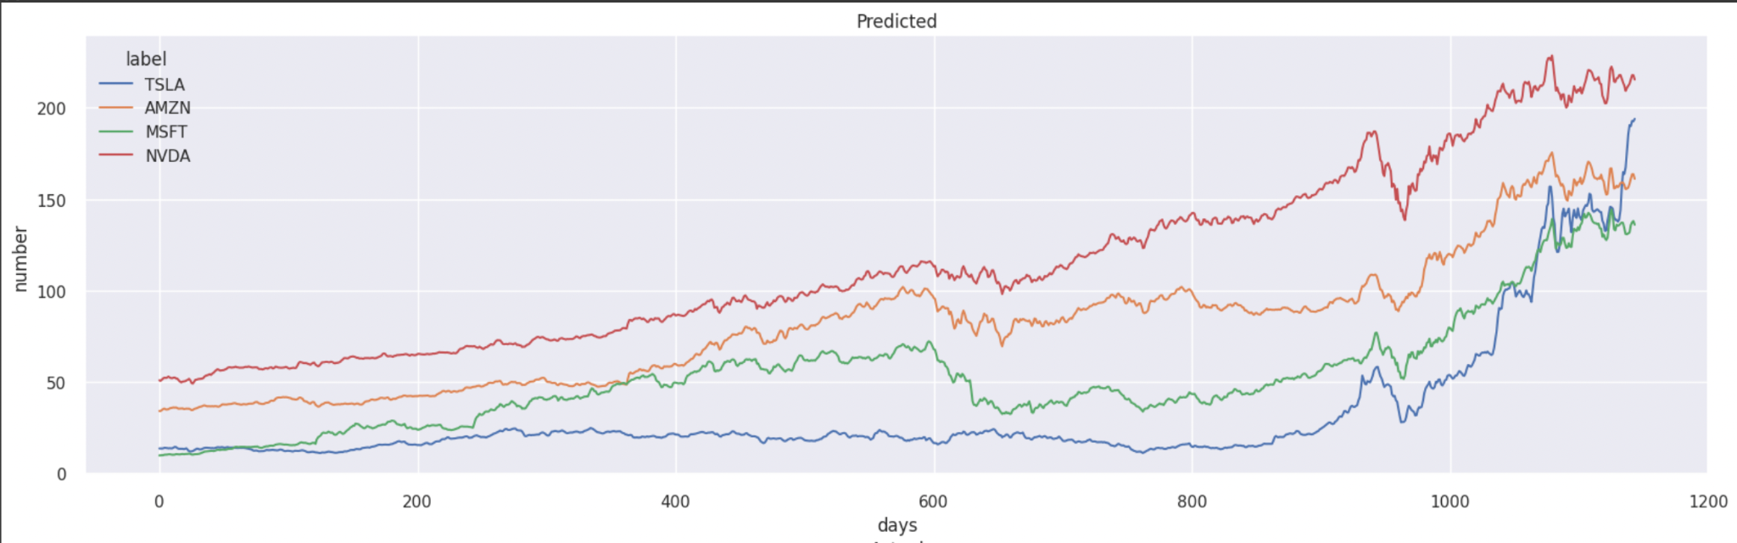
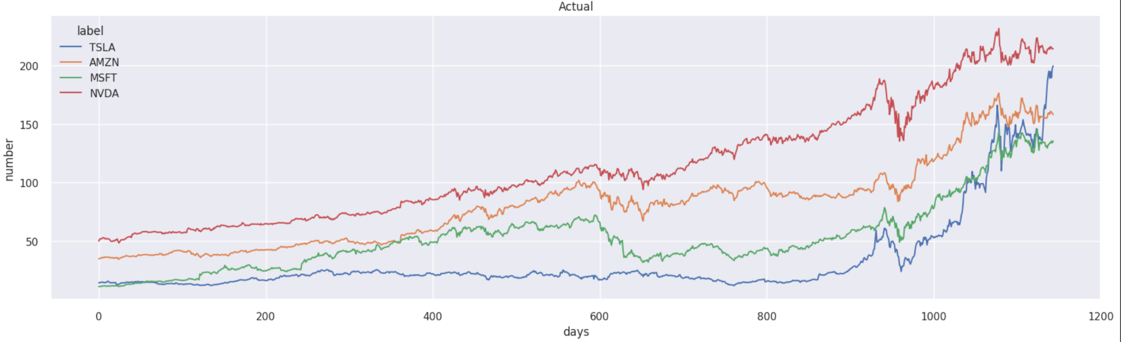
Train : Predicted VS Actual Stock Price

Slide 29
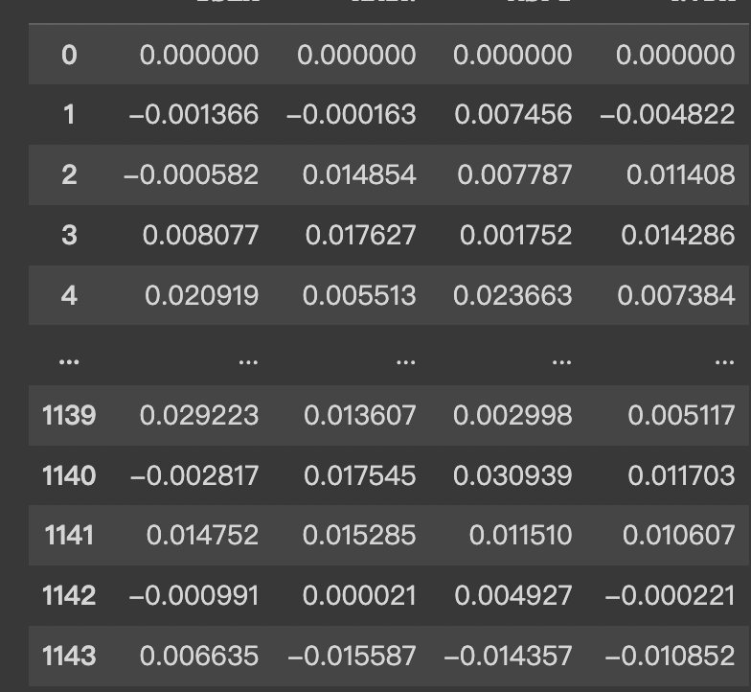
Expected Return
Generated by help function :
functions.py

Slide 30
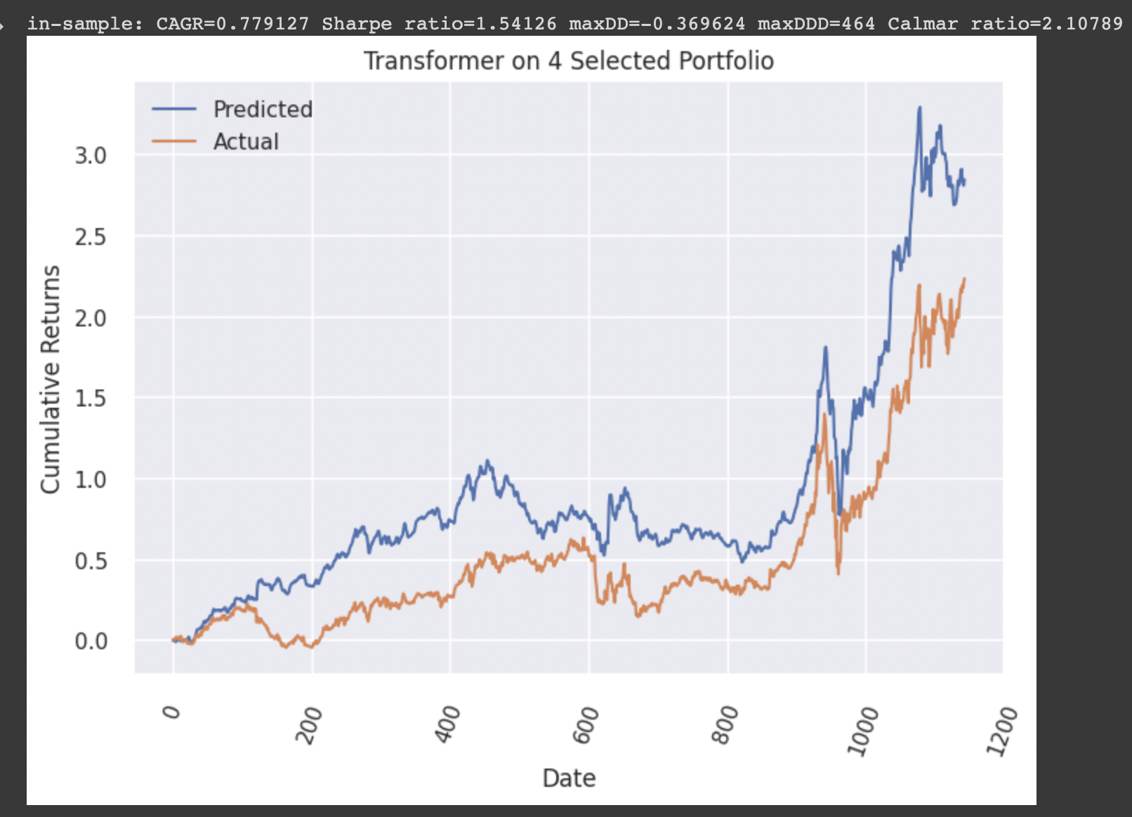
Predicted Cumulative Return VS Actual Return

Slide 31
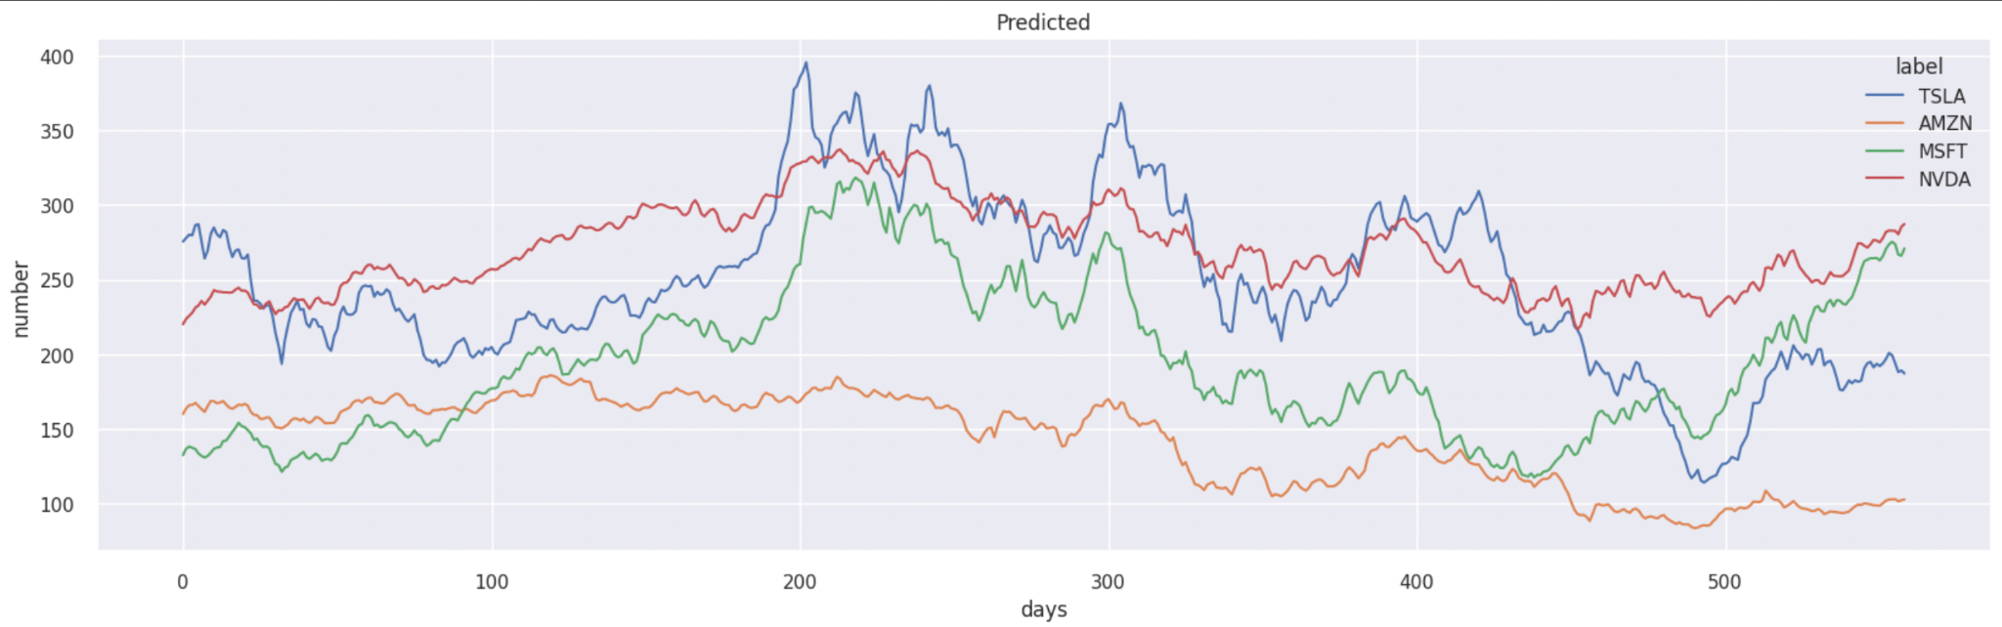
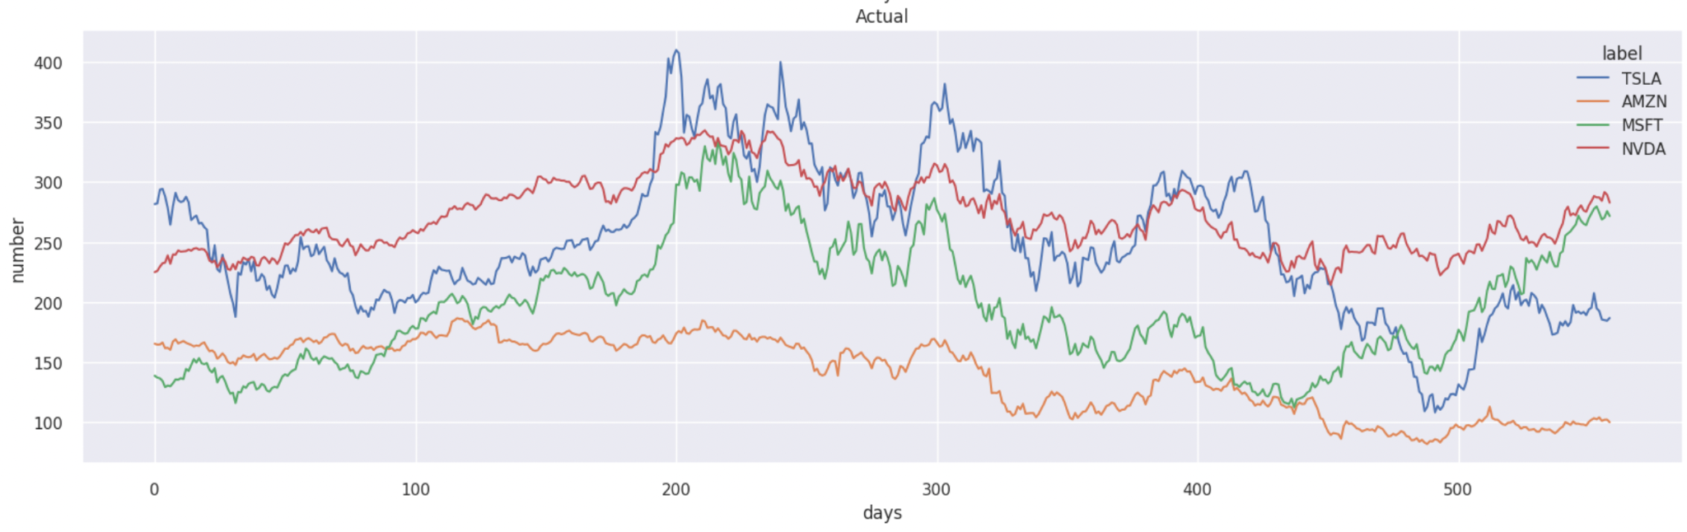
Test : Predicted VS Actual Stock Price

Slide 32
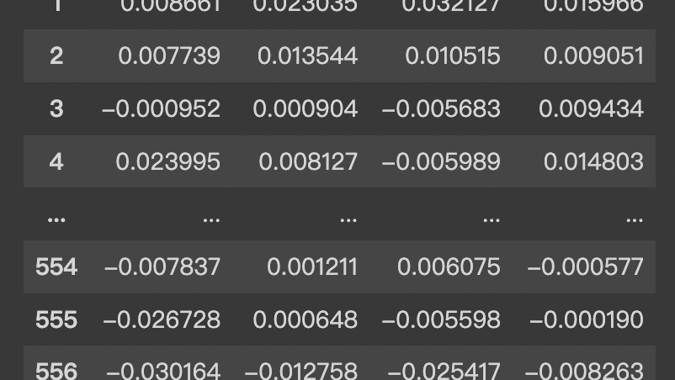
Expected Return
Applied help function :
functions.py

Slide 33
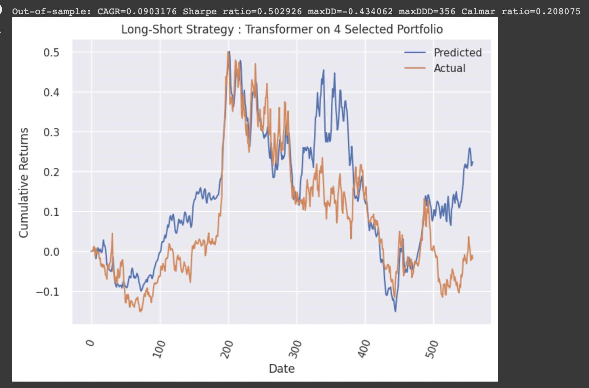
Predicted Cumulative Return VS Actual Return

Slide 34
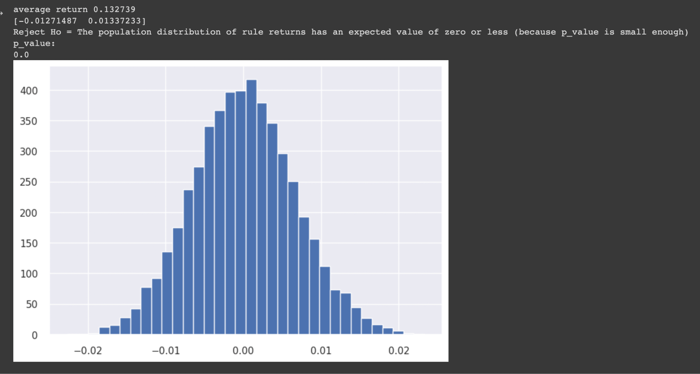
White Reality Check - Transformer prediction

Slide 35
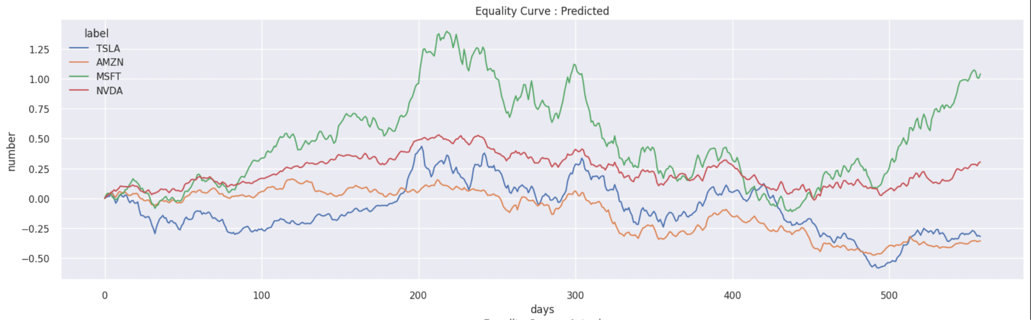
Equity Curve - Transformer

Slide 36
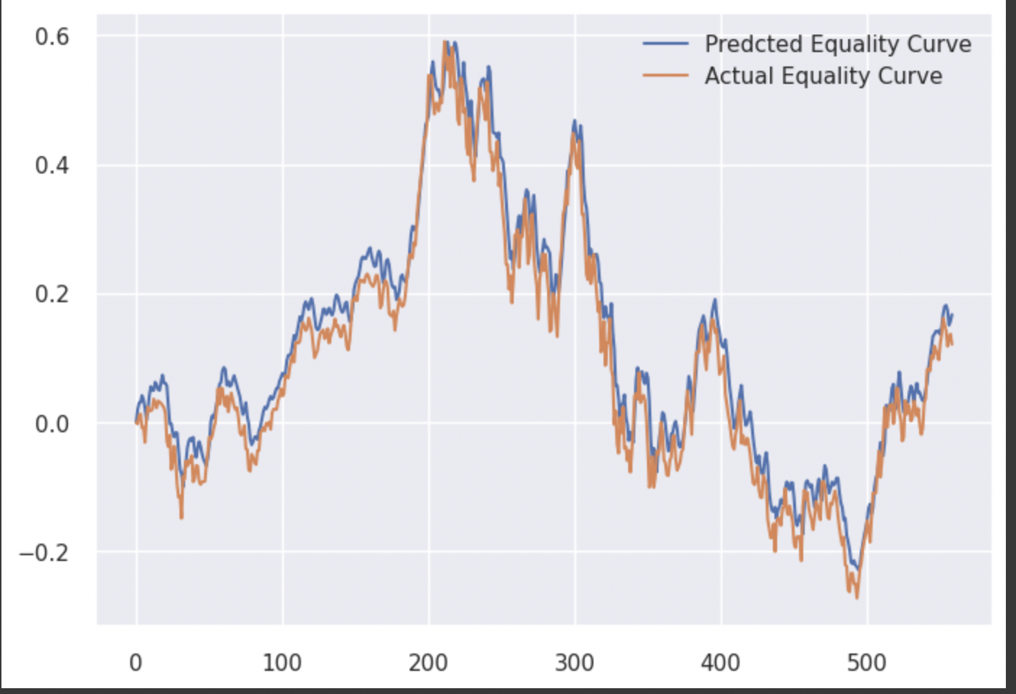
Average Equity Curve - Transformer - Actual VS Predicted

Slide 37
Reflection
LSTM model performs better than Transformer model on testing data, but worse on training data. This may be because of insufficient training with only 50 epochs. Transformer model incorporates ‘attention’ structure, it may be beneficial to use more than 30 days’ stock price to apply. But transformer model usually overestimates the daily close price because of insufficient training data by looking at the average equity curves.
As reflected by white reality check, the cumulative return on predictions of both models tell us that our trading algorithm will get a cumulative return higher than 0.

Slide 38
Discussion and Improvement
On both LSTM and Transformer models, we applied input data with min-max transformation to force all data into one specific range, it is helpful during training process. However, min-max method may be troublesome while making prediction.
For each model, we still could do some improvement. For example, we could increase the number of epochs for LSTM model, we could also increase the number of heads in multi-head attention layer.
We only use close price as input and output, our models may be inaccurate without the help of many financial factors. We could add dimensions of our input data by adding several daily financial factors and indicators.

Slide 39
Reference
https://news-by-ai.com/business/top-8-stocks-to-invest-in-april-2023/?gclid=CjwKCAjwrdmhBhBBEiwA4Hx5g6twhJSYa3IqtfLknxClHOuumLuNlfyrj-upCsJhOvuaV7v2FpDoCRoCSvcQAvD_BwE
https://github.com/ojus1/Date2Vec
https://github.com/ojus1/Time2Vec-PyTorch
https://sh-tsang.medium.com/review-attention-is-all-you-need-transformer-96c787ecdec1
https://towardsdatascience.com/transformers-141e32e69591

